Slide 1
Fourier series

Slide 2
1. Find the Fourier series of the function f(x)=x+x^2 in the interval (-π, π)
load(fourie);
(declare(n,integer), assume(n>0), facts() );
l:fourier(x+x^2,x,%pi);
fourexpand(l,x,%pi,6);
fs(nmax):=fourexpand(l,x,%pi,6);
load(draw); wxdraw2d(grid=true,
xrange=[-π, π],
yrange=[-π, π],
color=red,
line_width=2,
explicit(x+x^2,x, -π, π),
color=blue,
line_width=2,
explicit(fs(3),x,- π, π));

Slide 3
load(fourie);
(declare(n,integer), assume(n>0), facts() );
l:fourier(x+x^2,x,%pi);
fourexpand(l,x,%pi,6);
fs(nmax):=fourexpand(l,x,%pi,6);

Slide 4
load(draw); wxdraw2d(grid=true,
xrange=[-π, π],
yrange=[-π, π],
color=red,
line_width=2,
explicit(x+x^2,x, -π, π),
color=blue,
line_width=2,
explicit(fs(3),x,- π, π));

Slide 5
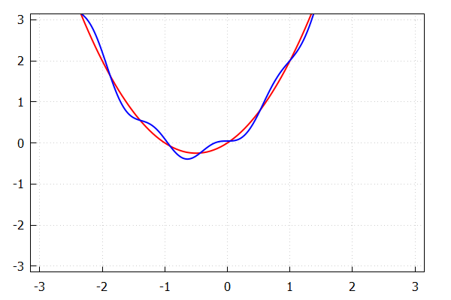
Output

Slide 6
2. Find the Fourier series of the function f(x)=lxl in (-2,2)
p:fourier(abs(x),x,2);
fourexpand(p,x,2,4);
fs(nmax):=fourexpand(p,x,2,4); load(draw); wxdraw2d(grid=true,
xrange=[-2, 2],
yrange=[-2, 2],
color=red,
line_width=2,
explicit(abs(x),x, -2, 2),
color=blue,
line_width=2,
explicit(fs(6),x,- 2, 2));

Slide 7
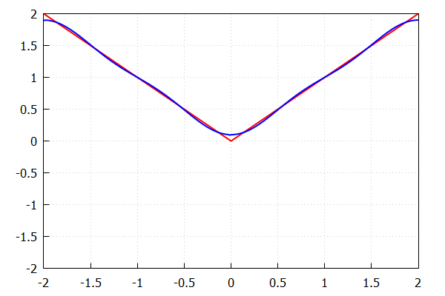
output

Slide 8
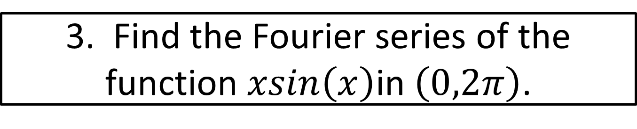
3. Find the Fourier series of the function $xsin\left(x\right)$in $\left(0,2π\right)$.
load(fourie);
(declare(n,integer), assume(n>0), facts() );
l:fourier(x*sin(x),x,2*%pi);
fs(nmax):=a0/2+sum(a(m)*cos(m*%pi*x/2),m,1,nmax)$
map('fs, [1,3,5]);

Slide 9
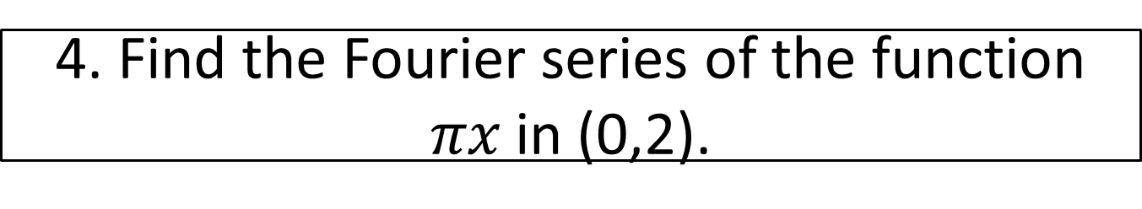
4. Find the Fourier series of the function $πx$ in (0,2).
kill(all);
load(fourie);
(declare(n,integer), assume(n>0), facts() );
l:fourier(%pi*(x),x,2);
fs(nmax):=sum(b(m)*sin(m*x),m,1,nmax)$
map(' fs, [1,2,3,4]);

Slide 10
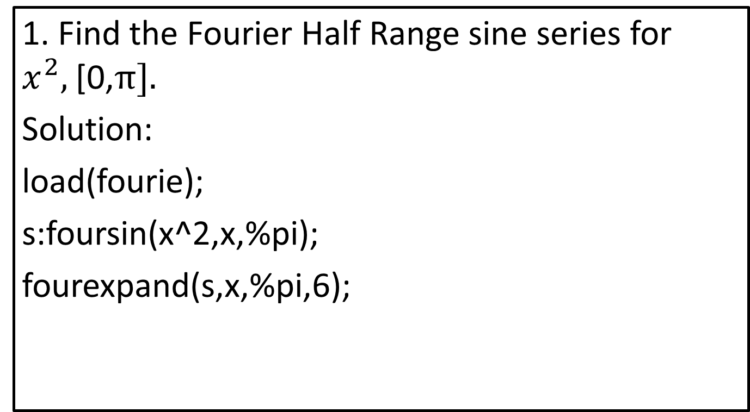
Half Range Fourier cosine and sine series
1. Find the Fourier Half Range sine series for $x^{2},$[0,$π].$
Solution:
load(fourie);
s:foursin(x^2,x,%pi);
fourexpand(s,x,%pi,6);

Slide 11
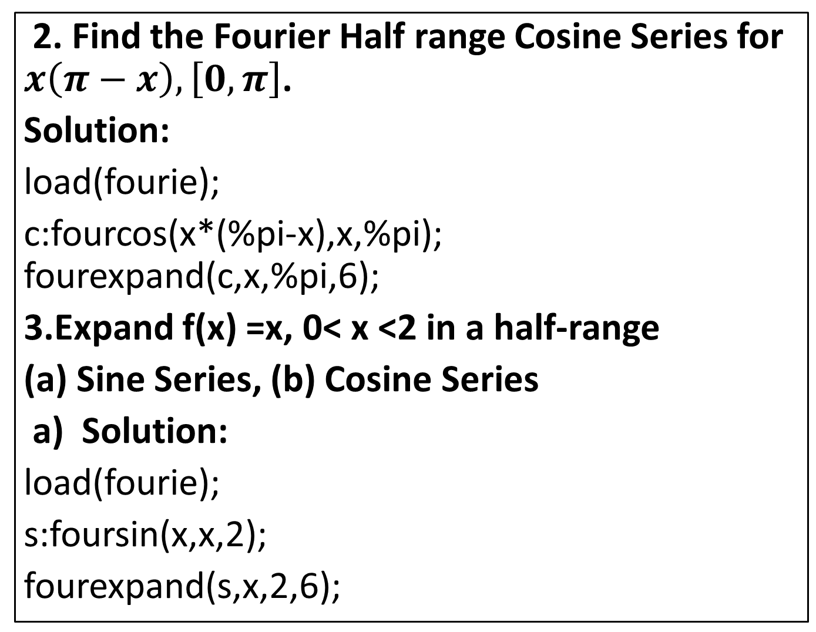
2. Find the Fourier Half range Cosine Series for $x\left(π−x\right),\left[0,π\right]$.
Solution:
load(fourie);
c:fourcos(x*(%pi-x),x,%pi); fourexpand(c,x,%pi,6);
3.Expand f(x) =x, 0< x <2 in a half-range
(a) Sine Series, (b) Cosine Series
a) Solution:
load(fourie);
s:foursin(x,x,2);
fourexpand(s,x,2,6);

Slide 12
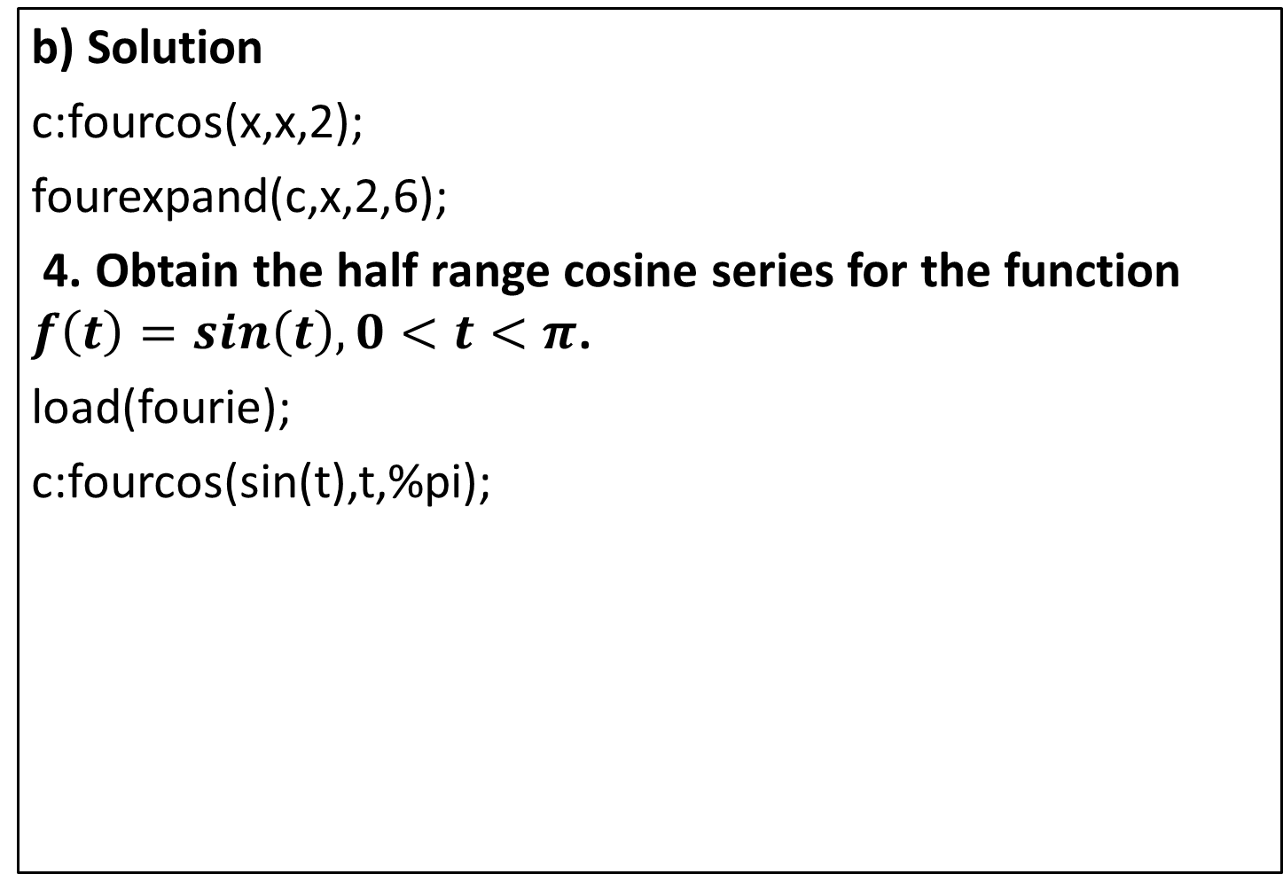
b)Solution
c:fourcos(x,x,2);
fourexpand(c,x,2,6);
4. Obtain the half range cosine series for the function $f\left(t\right)=sin\left(t\right),0<t<π$.
load(fourie);
c:fourcos(sin(t),t,%pi);

Slide 13
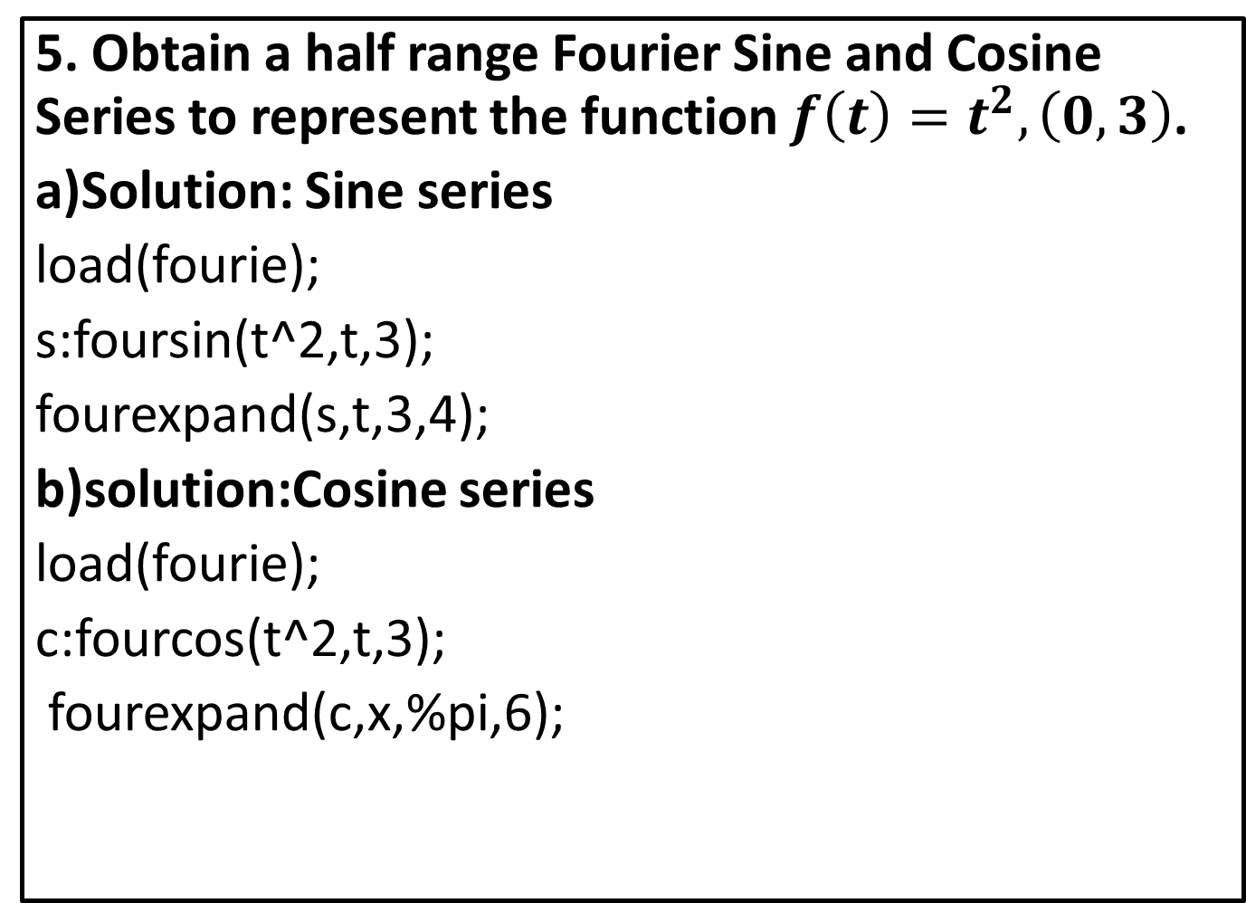
5. Obtain a half range Fourier Sine and Cosine Series to represent the function $f\left(t\right)=t^{2},\left(0,3\right)$.
a)Solution: Sine series
load(fourie);
s:foursin(t^2,t,3);
fourexpand(s,t,3,4);
b)solution:Cosineseries
load(fourie);
c:fourcos(t^2,t,3);
fourexpand(c,x,%pi,6);

Slide 14
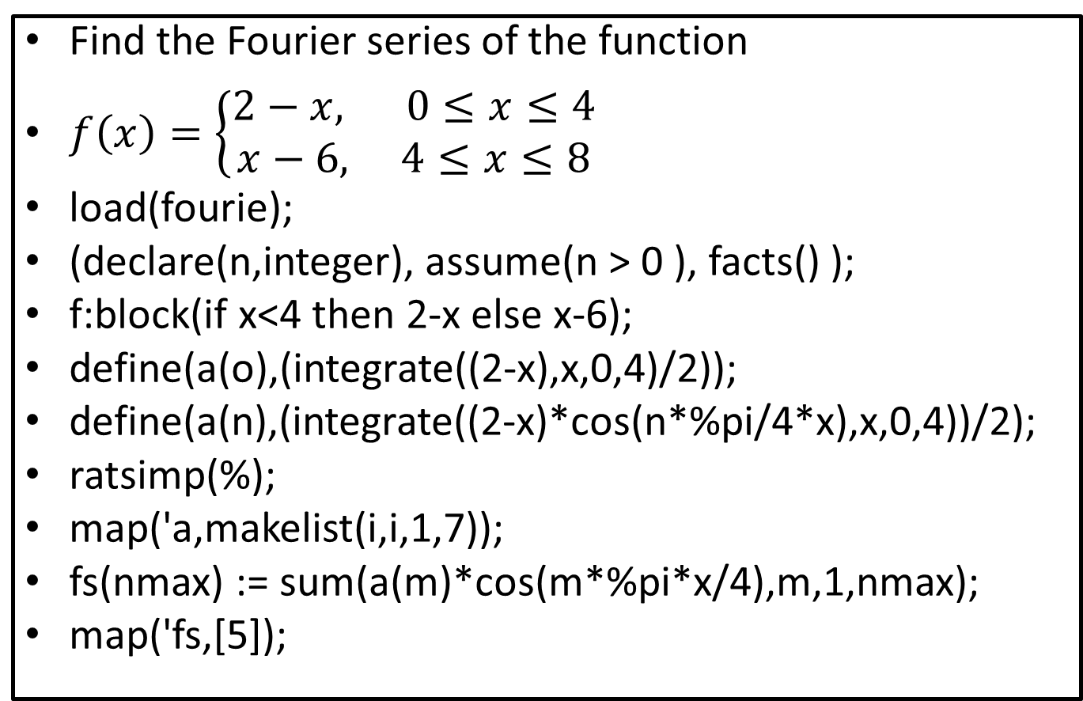
Fourier series of Step function
Find the Fourier series of the function
$f\left(x\right)=\left\{\begin{aligned}2−x, 0≤x≤4 \\ x−6, 4≤x≤8\end{aligned}\right.$
load(fourie);
(declare(n,integer), assume(n > 0 ), facts() );
f:block(if x<4 then 2-x else x-6);
define(a(o),(integrate((2-x),x,0,4)/2));
define(a(n),(integrate((2-x)*cos(n*%pi/4*x),x,0,4))/2);
ratsimp(%);
map('a,makelist(i,i,1,7));
fs(nmax) := sum(a(m)*cos(m*%pi*x/4),m,1,nmax);
map('fs,[5]);

Slide 15
Harmonic Analysis
Find the constant term and the coefficients of the first sine and cosine terms in the fourier expansion of y using the given data
makelist(k,k,0,5);
makelist(%pi*k/3,k,0,5);
y:append([9,18,24,28,26,20]);
sumy:apply("+",%);
y1:makelist(cos(%pi*k/3),k,0,5);
sumy1:apply("+",y1*y);
z1:makelist(sin(%pi*k/3),k,0,5);
sumz1:apply("+",z1*y);
a0:float(2*sumy/6);
a1:float(2*sumy1/6);
b1:float(2*sumz1/6);
x 0 | 1 | 2 | 3 | 4 | 5
Y 9 | 18 | 24 | 28 | 26 | 20

